Slide 1
Using Cloud Foundry CLI
IBM Cloud Ecosystem Development team

Slide 2

Using Cloud Foundry
Command Line Interfaces to
Manage Applications
IBM Bluemix
Notes:
Developers can build, deploy, test and manage applications and environment via Console UI or Command Line Interface in Bluemix platform.

Slide 3
Download and install Cloud Foundry CLI
CF-CLI download https://github.com/cloudfoundry/cli/releases
Windows
  Unpack the zip file.
  Double click the cf executable.
  When prompted, click Install, and then Close.
MAC OSX and Linux Installation
  Open the .pkg file.
  In the installer wizard, click Continue.
  Select an install destination and click Continue.
  When prompted, click Install.
Notes:
Download CF-CLI from https://github.com/cloudfoundry/cli/releases
Windows
Unpack the zip file.
Double click the cf executable.
When prompted, click Install, and then Close.
MAC OSX and Linux Installation
Open the .pkg file.
In the installer wizard, click Continue.
Select an install destination and click Continue.
When prompted, click Install.

Slide 4
Cloud Foundry Command Line Interface Summary
Bluemix uses the CloudFoundry command line interface (CLI)
  cf – A command line tool to interact with Cloud Foundry
  cf help – provides help page showing all the commands
  cf help <command> - provides help for specific command
cf l - login | cf ds – delete service
cf t – target space or organisation | cf bs – bind service to application
cf a – list apps in current space | cf st – start app
cf app - display status for specific app in current space | cf sp – stop app
cf p – push (deploy or update) app | cf d – delete app
cf s – show service info | cf scale – scale app
cf cs – create service | cf logs – tail or show logs for app
cf m – list available marketplace offering | cf r – list all routes in current space
Notes:
cf command is a command line tool to interact with Cloud Foundry. The cf CLI v6 command aliases and command line help feature improved consistency and convenience. The cf CLI v6 introduces single-letter aliases for commonly used commands. For example:
cf p is the alias for cf push.
cf t is the alias for cf target.
The cf CLI v6 command line help introduces streamlined style conventions:
User input is capitalized, as in cf push APP.
Optional user input is designated with a flag and brackets, as in cf create-route SPACE DOMAIN [-n HOSTNAME].
Run cf help to view a list of all cf CLI commands and a brief description of each. Run cf <command-name> -h to view detailed help (including alias) for any command.

Slide 5
Login to Bluemix Cloud Foundry Using Command Line Interface
Usage
  cf login [-a API_URL] [-u USERNAME] [-p PASSWORD] [-o ORG] [-s SPACE]
Arguments:
  API endpoint: This is the URL of the Cloud Controller in your Cloud Foundry instance.
  Username: Your username, such as your Bluemix ID
  Password: Your password.
  Org: The organization where you want to deploy your application.
  Space: The space in the organization where you want to deploy your application.
Example : cf login –a https://api.ng.bluemix.net –u developer@us.ibm.com -p XXXX –o developer@us.ibm.com -s dev
Notes:
The login command in the cf CLI v6 has expanded functionality. In addition to your username and password, you can provide a target API endpoint, organization, and space. If not specified on the command line, the cf CLI prompts for:
Usage
cf login [-a API_URL] [-u USERNAME] [-p PASSWORD] [-o ORG] [-s SPACE]
Arguments:
API endpoint: This is the URL of the Cloud Controller in your Cloud Foundry instance.
Username: Your username.
Password: Your password.
Org: The organization where you want to deploy your application.
Space: The space in the organization where you want to deploy your application.
Example : cf login –a https://api.ng.bluemix.net –u developer@us.ibm.com -p XXXX –o developer@us.ibm.com -s dev

Slide 6
Push an application to Bluemix Cloud Foundry
Usage :
  cf push APP [-b URL] [-c COMMAND] [-d DOMAIN] [-i NUM_INSTANCES] [-m MEMORY] [-n HOST] [-p PATH] [-s STACK] [--no-hostname] [--no-route] [--no-start]
Arguments:
  -b — Custom buildpack URL, for example, https://github.com/heroku/heroku-buildpack-play.git or https://github.com/heroku/heroku-buildpack-play.git#stable to select stable branch
  -c — Start command for the application.
  -d — Domain, for example, example.com.
  -f — replaces --manifest
  -i — Number of instances of the application to run.
  -m — Memory limit, for example, 256, 1G, 1024M, and so on.
  -n — Hostname, for example, my-subdomain.
  -p — Path to application directory or archive.
  -s — Stack to use.
  -t — Timeout to start in seconds, give your application more time to start, up to 180 secs. --no-hostname — Map the root domain to this application (NEW).
  --no-manifest — Ignore manifests if they exist.
  --no-route — Do not map a route to this application (NEW).
  --no-start — Do not start the application after pushing.
Example: cf push my-app -c “node my-app.js”
Notes:
This push command in CF CLI allows you deploy and start your application in Cloud Foundry
Usage :
cf push APP [-b URL] [-c COMMAND] [-d DOMAIN] [-i NUM_INSTANCES] [-m MEMORY] / [-n HOST] [-p PATH] [-s STACK] [--no-hostname] [--no-route] [--no-start]
Arguments:
-b — Custom buildpack URL, for example, https://github.com/heroku/heroku-buildpack-play.git or https://github.com/heroku/heroku-buildpack-play.git#stable to select stable branch
-c — Start command for the application.
-d — Domain, for example, example.com.
-f — replaces --manifest
-i — Number of instances of the application to run.
-m — Memory limit, for example, 256, 1G, 1024M, and so on.
-n — Hostname, for example, my-subdomain.
-p — Path to application directory or archive.
-s — Stack to use.
-t — Timeout to start in seconds.
--no-hostname — Map the root domain to this application (NEW).
--no-manifest — Ignore manifests if they exist.
--no-route — Do not map a route to this application (NEW).
--no-start — Do not start the application after pushing.
Example: cf push my-app -c "node my-app.js"

Slide 7
Scale your Application by using Cloud Foundry CLI
Scaling an application - Adjustments of resources required by running the application to improve overall performance
Cloud Foundry provides cf scale command to scale your application up or down horizontally and vertically to meet demand of workload
Scaling horizontally
  cf scale APP -i INSTANCES to horizontally scale your application
  Cloud Foundry will increase or decrease the number of instances of your application to match INSTANCES
  Example: cf scale myApp –i 5
Scale vertically
  Vertically scaling an application changes the disk space limit or memory limit that Cloud Foundry applies to all instances of the application
  Change disk space limit: cf scale App –k DISK
  DISK must be an integer followed by either an M, for megabytes, or G, for gigabytes.
  Example: cf scale myApp -k 512M or cf scale myApp -k 1G
Notes:
Factors such as user load, or the number and nature of tasks performed by an application, can change the disk space and memory the application uses. For many applications, increasing the available disk space or memory can improve overall performance. Similarly, running additional instances of an application can allow the application to handle increases in user load and concurrent requests. These adjustments are called scaling an application.
Command for scaling
Use cf scale to scale your application up or down to meet changes in traffic or demand.
Scaling Horizontally
Command for scaling horizontally: Use cf scale APP -i INSTANCES to horizontally scale your application. Cloud Foundry will increase or decrease the number of instances of your application to match INSTANCES.
Example: cf scale myApp –i 5
Scaling Vertically: Vertically scaling an application changes the disk space limit or memory limit that Cloud Foundry applies to all instances of the application.
Command for scaling vertically: Use cf scale APP -k DISK to change the disk space limit applied to all instances of your application. DISK must be an integer followed by either an M, for megabytes, or G, for gigabytes.
Example: cf scale myApp -k 512M
Example: cf scale myApp -m 1G

Slide 8
Application Loggregator
user application logging subsystem of Cloud Foundry
Loggregator allows users to:
  Tail their application logs
  Dump a recent set of application logs (where recent is a configurable number of log packets).
  Continually drain their application logs to 3rd party log archive and analysis services.
  (Operators and administrators only) Access the firehose, which includes the combined stream of logs from all apps, plus metrics data from CF components.
Usage : cf logs APP_NAME [--recent]
Notes:
Loggregator is the user application logging subsystem of Cloud Foundry
Loggregator allows users to:
• Tail their application logs.
• Dump a recent set of application logs (where recent is a configurable number of log packets).
• Continually drain their application logs to 3rd party log archive and analysis services.
• (Operators and administrators only) Access the firehose, which includes the combined stream of logs from all apps, plus metrics data from CF components.
• Usage : cf logs APP_NAME [--recent]

Slide 9
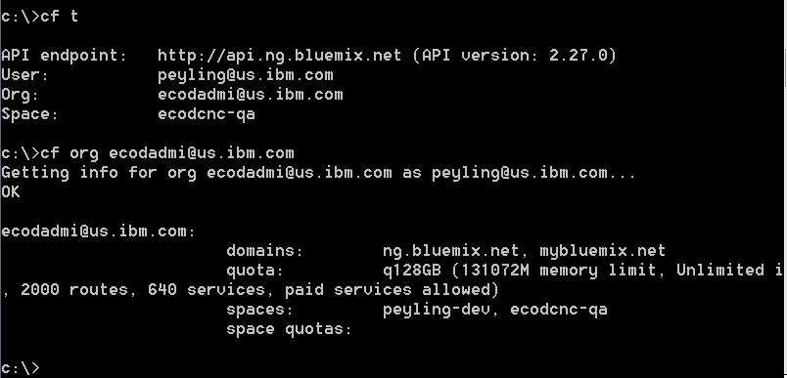
Manage Organizations Using Command Line Interface
To check what organization, and space you are logged onto or to change the space:
  cf target
  cf t -s test
    The first option will print the current target organization and space
    The second option will switch to the test space
To view your organization information such as domains, quota, spaces:
  cf org ORGNAME
Notes:
Using command line to manage Organization
To check what organization, and space you are logged onto or to change the space:
cf target
cf t -s test
The first option will print the current target organization and space
The second option will switch to the test space
To view your organization information such as domains, quota, spaces:
cf org ORGNAME

Slide 10
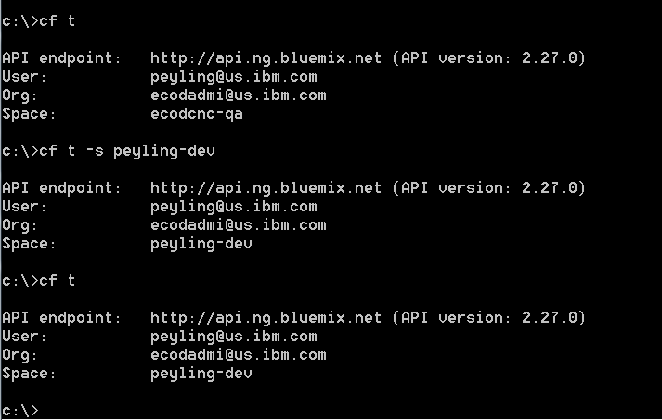
Manage Spaces Using Command Line Interface
To check what organization, and space you are logged onto or to change the space:
  cf target
  cf t -s test
    The first option will print the current target organization and space
    The second option will switch to the test space

Slide 11
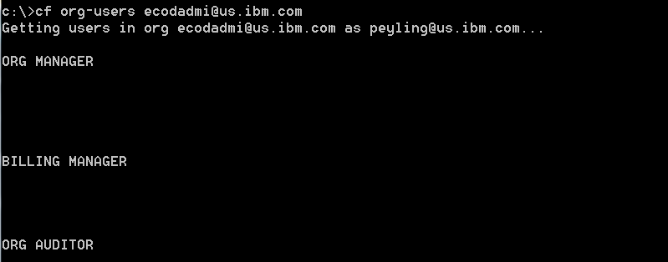
Manage Users and Roles of an Organization using CLI
Commands for listing users:
  cf org-users ORG — List users in the organization by role.
Commands for managing roles (admin-only) in your organization:
  cf set-org-role USERNAME ORG ROLE — Assign an organization role to a user. The available roles are “OrgManager”, “BillingManager”, and “OrgAuditor”.
  cf unset-org-role USERNAME ORG ROLE — Remove an organization role from a user.
Notes:
Users and Roles
Commands for listing users:
cf org-users — List users in the organization by role.
cf space-users — List users in the space by role.
Commands for managing roles (admin-only):
cf set-org-role — Assign an organization role to a user. The available roles are “OrgManager”, “BillingManager”, and “OrgAuditor”.
cf unset-org-role — Remove an organization role from a user.
cf set-space-role — Assign a space role to a user. The available roles are “SpaceManager”, “SpaceDeveloper”, and “SpaceAuditor”.
cf unset-space-role — Remove a space role from a user.

Slide 12
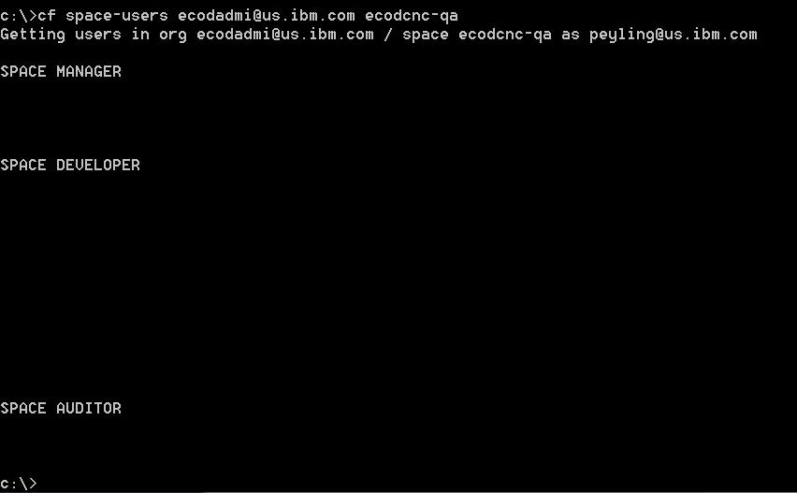
Manage Users and Roles of a Space using Command Line Interface
Commands for listing users:
  cf space-users ORG SPACE— List users in the space by role.
Commands for managing roles (admin-only) in your organization:
  cf set-space-role — Assign a space role to a user. The available roles are “SpaceManager”, “SpaceDeveloper”, and “SpaceAuditor”.
  cf unset-space-role — Remove a space role from a user.
Notes:
Users and Roles
Commands for listing users:
cf org-users — List users in the organization by role.
cf space-users — List users in the space by role.
Commands for managing roles (admin-only):
cf set-org-role — Assign an organization role to a user. The available roles are “OrgManager”, “BillingManager”, and “OrgAuditor”.
cf unset-org-role — Remove an organization role from a user.
cf set-space-role — Assign a space role to a user. The available roles are “SpaceManager”, “SpaceDeveloper”, and “SpaceAuditor”.
cf unset-space-role — Remove a space role from a user.

Slide 13
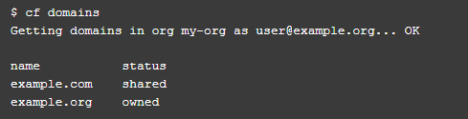
Manage Domains Using Command Line Interface
All domains are mapped to an Organization
Domains can be shared or private. Shared domains are registered to multiple orgs while private domains, or owned domains, are registered to one org. A Cloud Foundry instance defines a default shared domain that your application uses unless you specify a different domain.
To list domains in the target organization - cf domains
Commands for managing domains:
  cf create-domain — Create a domain.
  cf delete-domain — Delete a domain.
  cf create-shared-domain — Share a domain with all organizations. Admin only.
  cf delete-shared-domain — Delete a domain that was shared with all organizations. Admin only.
Notes:
The relationships between domains, routes, organizations, and spaces have been simplified in cf CLI v6. The term domain in this topic differs from its common use and is specific to Cloud Foundry.
All domains are now mapped to an org. As before, a route is a URL of the form HOSTNAME.DOMAIN. If you do not provide a hostname (also known as subdomain), the URL takes the form APPNAME.DOMAIN. Domains can be shared or private. Shared domains are registered to multiple orgs while private domains, or owned domains, are registered to one org. A Cloud Foundry instance defines a default shared domain that your application uses unless you specify a different domain.
The cf CLI v6 has improved separation between management of private domains and management of shared domains. Only administrators can manage shared domains.
In terms of domains, cf CLI v6 is designed to work with both new and older versions of cf_release.
Note: The map-domain and unmap-domain commands no longer exist.
Commands for managing domains:
cf create-domain — Create a domain.
cf delete-domain — Delete a domain.
cf create-shared-domain — Share a domain with all organizations. Admin only.
cf delete-shared-domain — Delete a domain that was shared with all organizations. Admin only.

Slide 14
Manage Routes Using Command Line Interface
A route is a path used to access an application online. Each route is directly bound to one or more applications in Cloud Foundry. A route is a URL composed of a domain and an optional host as a prefix.
Example, “myappname” is the host and “example.com” is the domain in the route “myappname.example.com.” Here “example.com” could either be a custom domain of your own, or a domain that you have created through Cloud Foundry.
The command cf routes lists all routes in the current space or current organization and its related space, host, domain and application name.
Commands for managing routes:
  cf create-route — Create a route.
  cf map-route — Map a route to an application. If the route does not exist, this command creates it and then maps it.
  cf unmap-route — Remove a route from an application.
  cf delete-route — Delete a route.
Notes:
A route is a path used to access an application online. Each route is directly bound to one or more applications in Cloud Foundry. A route is a URL composed of a domain and an optional host as a prefix. For example, “myappname” is the host and “example.com” is the domain in the route “myappname.example.com.” Here “example.com” could either be a custom domain of your own, or a domain that you have created through Cloud Foundry.
Commands for managing routes:
cf create-route — Create a route.
cf map-route — Map a route to an application. If the route does not exist, this command creates it and then maps it.
cf unmap-route — Remove a route from an application.
cf delete-route — Delete a route.
Mapping a Route
Use cf create-domain to create a domain in the desired organization, unless the domain already exists in (or has been shared with) the organization.
Use cf map-route to map the domain to an application. Use the -n HOSTNAME option to specify a unique hostname for each route that uses the same domain.
Note: You can map a single route to multiple applications in the same space. See Blue-Green Deployment to learn about an important extension of this technique.
Users and Roles
Commands for listing users:
cf org-users — List users in the organization by role.
cf space-users — List users in the space by role.
Commands for managing roles (admin-only):
cf set-org-role — Assign an organization role to a user. The available roles are “OrgManager”, “BillingManager”, and “OrgAuditor”.
cf unset-org-role — Remove an organization role from a user.
cf set-space-role — Assign a space role to a user. The available roles are “SpaceManager”, “SpaceDeveloper”, and “SpaceAuditor”.
cf unset-space-role — Remove a space role from a user.

Slide 15
Bookmarks & References
https://www.ng.bluemix.net/docs/#services/services.html
https://www.ng.bluemix.net/docs/#overview/overview.html#overview
https://www.ng.bluemix.net/docs/#overview/overview.html#ov_intro__reg
http://docs.cloudfoundry.org/devguide/installcf/whats-new-v6.html
https://www.ng.bluemix.net/docs/#
http://docs.cloudfoundry.org/devguide/installcf/whats-new-v6.html#domains-etc

Slide 16
QUESTIONS?
Get help from Bluemix development team and Stack Overflow community
Visit: https://developer.ibm.com/bluemix/#support
Notes:
Please post your questions or find the answers on Bluemix Community https://ibm.biz/BdXGBL

